Slide 1

Customer Purchase Insights
10 SQL queries revealing behavior patterns, revenue drivers, and strategic opportunities

Slide 2

Revenue by Gender
Gender Distribution Analysis
Breakdown of total purchase revenue across customer gender segments
Identifies primary revenue sources
Guides targeted marketing campaigns
Reveals customer base composition
Male
Female

Slide 3

Smart Spenders
High-Value Discount Users
Customers applying discounts while maintaining above-average spend
Strategic Insight
Discount codes don't always reduce revenue
Customer Behavior
Premium buyers leverage promotions

Slide 4

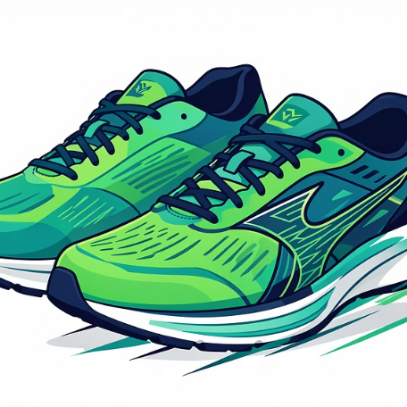



Top-Rated Products
Wireless Headphones
Running Shoes
Designer Handbag
Fitness Tracker
4.85 average rating
4.82 average rating
4.79 average rating
4.76 average rating
Bluetooth Speaker
4.74 average rating
Customer satisfaction leaders driving brand reputation and repeat purchases

Slide 5
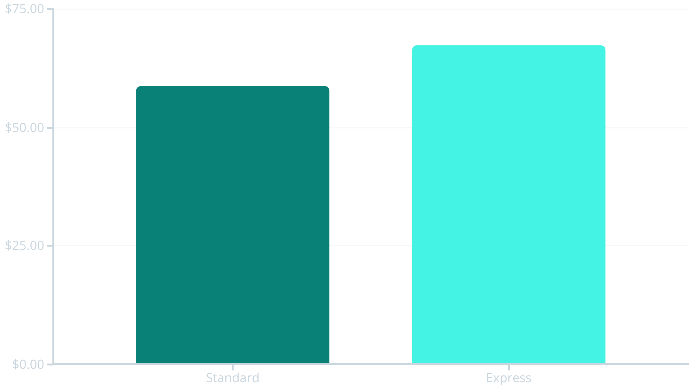

Shipping Impact on Spend
Premium Shipping Signals Higher Value
Express shipping customers spend 15% more per transaction on average
Recommendation: Promote express shipping at checkout to increase cart values

Slide 6

Subscription Value Analysis
2,847
$73.20
$208K
Total Subscribers
Avg Subscriber Spend
Subscriber Revenue
Active membership base
Per transaction value
Total contribution
$51.60
Non-Subscriber Avg
Lower per-transaction spend
Subscribers generate 42% higher average purchase value and drive significant revenue concentration

Slide 7
Discount-Driven Products
Top 5 Products by Discount Usage
Items most frequently purchased with promotional codes
78%
72%
68%
Sneakers
Backpack
T-Shirt
65%
61%
Jeans
Dress Shirt
Price-sensitive categories requiring strategic promotional balance to maintain margins

Slide 8
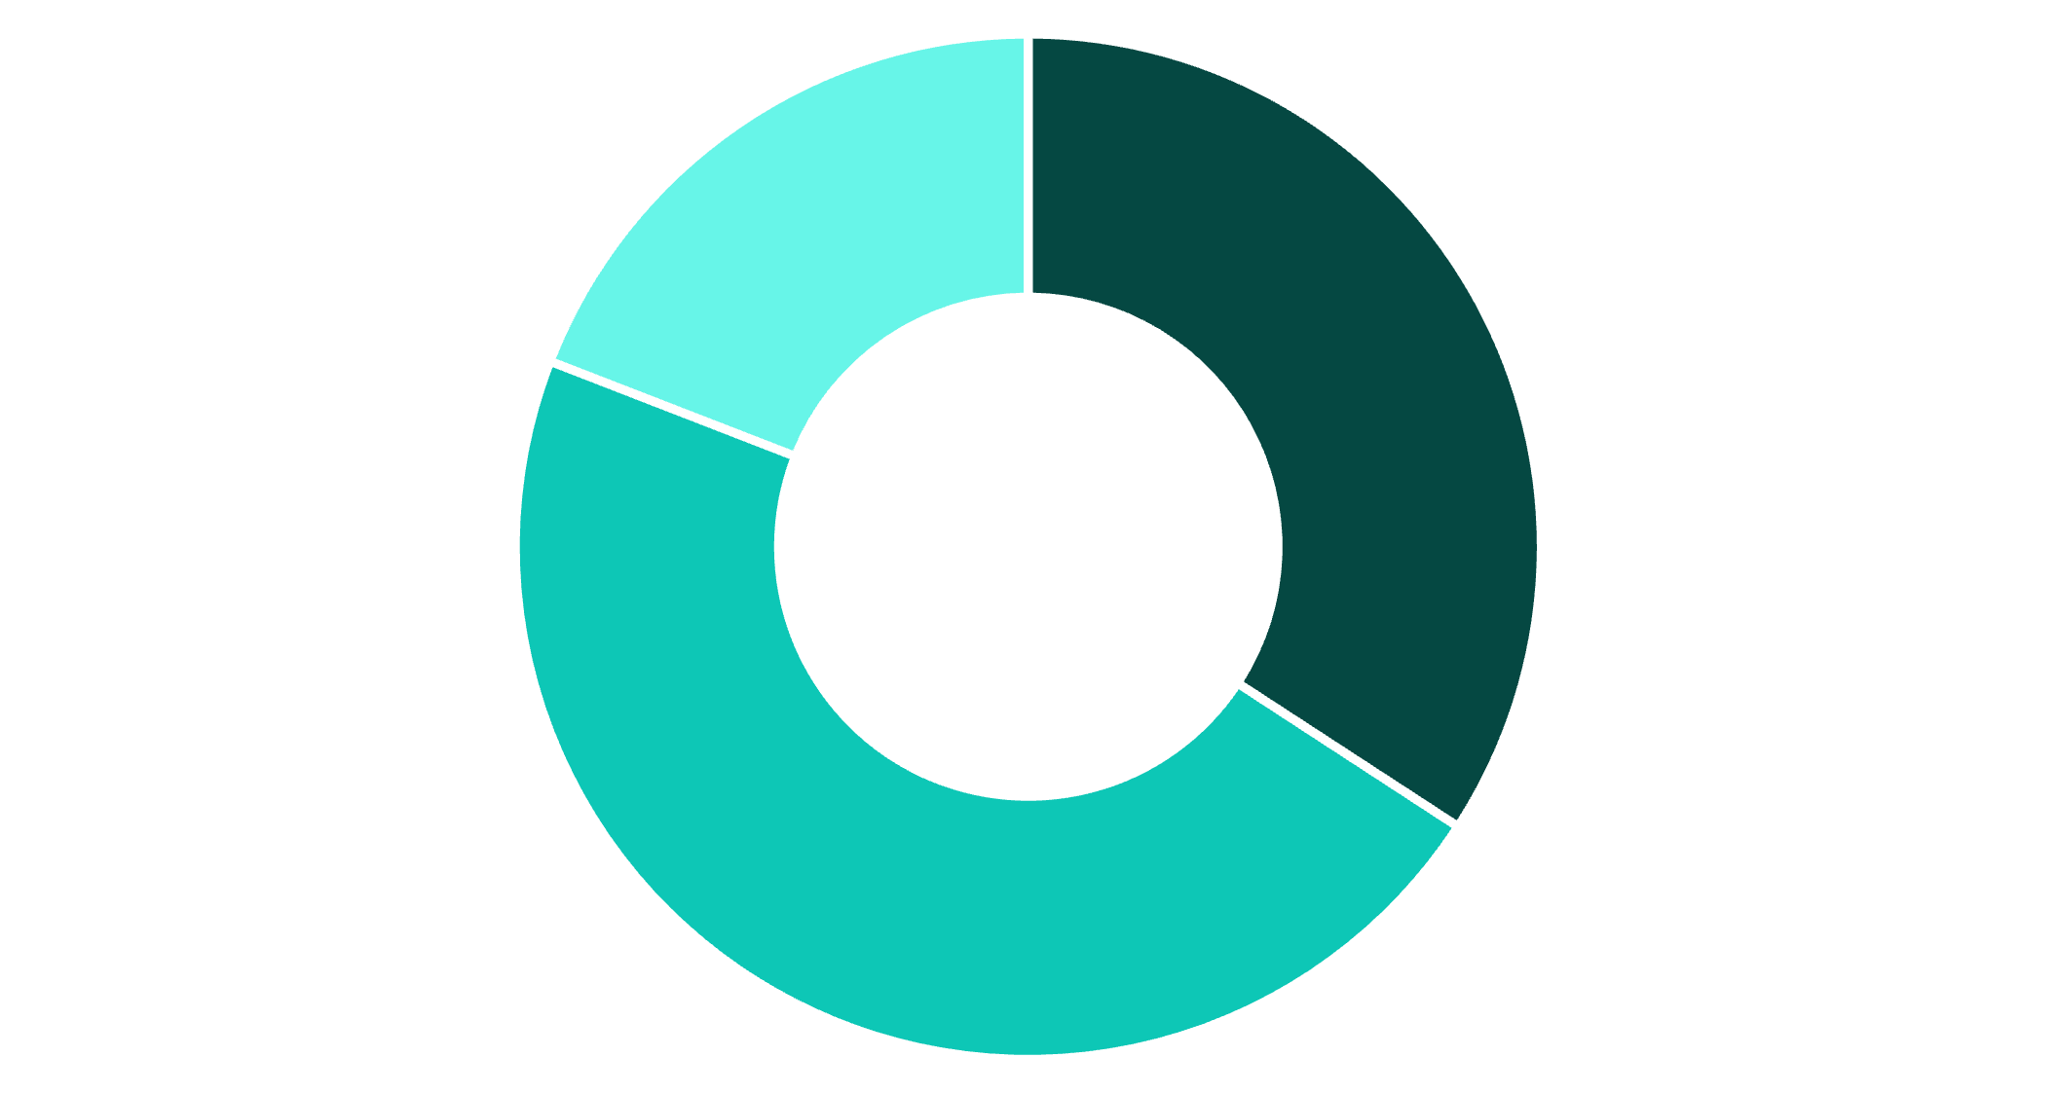
Customer Loyalty Segments
Segmentation Strategy
Customers categorized by purchase history patterns
01
New
1 previous purchase
02
Returning
2-10 purchases
03
Loyal
New
Returning
Loyal
11+ purchases

Slide 9

Category Bestsellers
Top 3 performing products within each category reveal customer preferences
Clothing
Footwear
Jeans
T-Shirt
Dress Shirt
Sneakers
Running Shoes
Sandals
Electronics
Accessories
Headphones
Fitness Tracker
Bluetooth Speaker
Handbag
Backpack
Sunglasses
Use these insights to optimize inventory, merchandising, and cross-sell recommendations

Slide 10
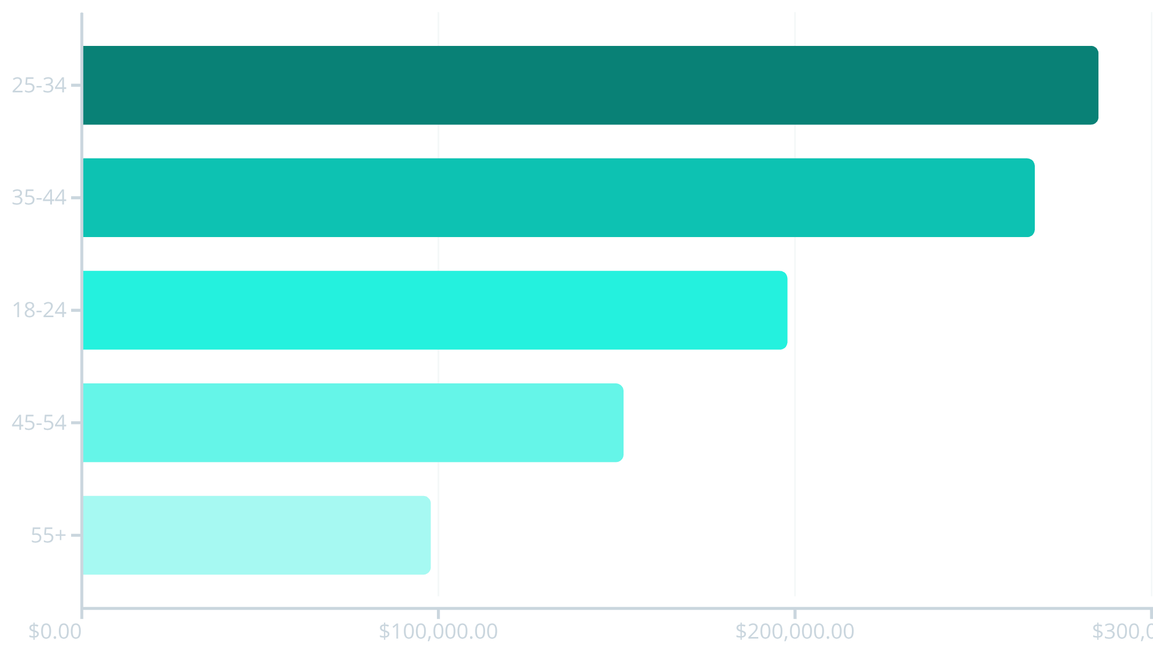
Age Group Revenue Contribution
Millennial Dominance
Ages 25-34 drive the highest revenue, followed closely by 35-44 demographic
Target marketing toward 25-44 age range
Develop retention programs for younger segments
Explore untapped potential in 55+ market

